Slide 1
Strings

Slide 2
Objectives
After studying this section, you should be able to:
The way is used to store a string of characters in C.
How to declare/initialize a string in C?
How to access a character in a string?
What are operations on strings
Input/output (stdio.h)
Some common used functions in the library string.h
How to manage an array of strings?

Slide 3
Contents
Null-String/C-String
Declare/Initialize a string
Data stored in a string
Output a String
Input a string
May Operators Applied to String?
Other String Functions
Array of Strings

Slide 4
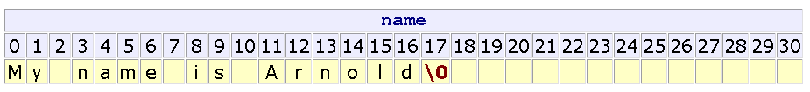
1. Null-String/ C-String
A string is a group of characters. It is similar to an array of characters.
A NULL byte (value of 0 - escape sequence ‘\0’) is inserted to the end of a string. It is called NULL-string or C-string.
A string is similar to an array of characters. The difference between them is at the end of a string, a NULL byte is inserted to locate the last meaningful element in a string.
If a string with the length n is needed, declare it with the length n+1.

Slide 5
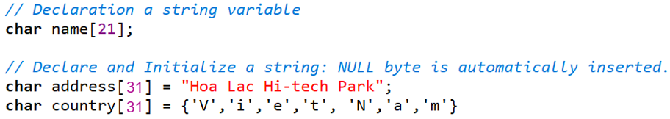
2. Declare/ Initialize a String
Static strings: stored in data segment or stack segment. Compiler can determine the location for storing strings.
Example:

Slide 6
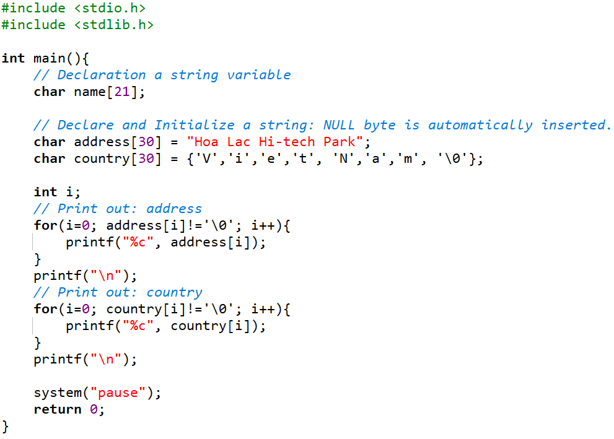
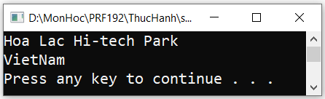
Static Strings: Example

Slide 7
2. Declare/ Initialize a String (cont.)
Dynamic strings: Stored in the heap
Syntax:
Note: Using malloc(…) and calloc(…) funtions in <stdlib.h>
char *str = (char *)malloc(length * sizeof(char));
or:
char *str = (char *)calloc(length, sizeof(char));

Slide 8
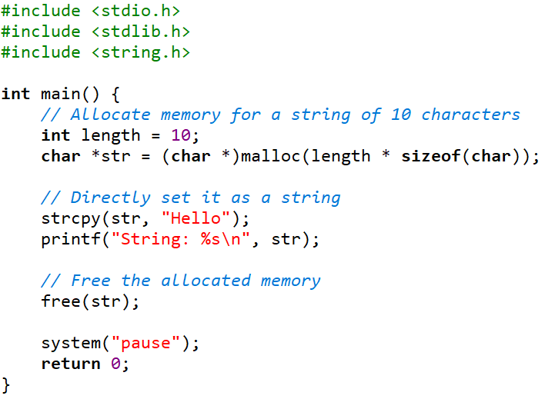
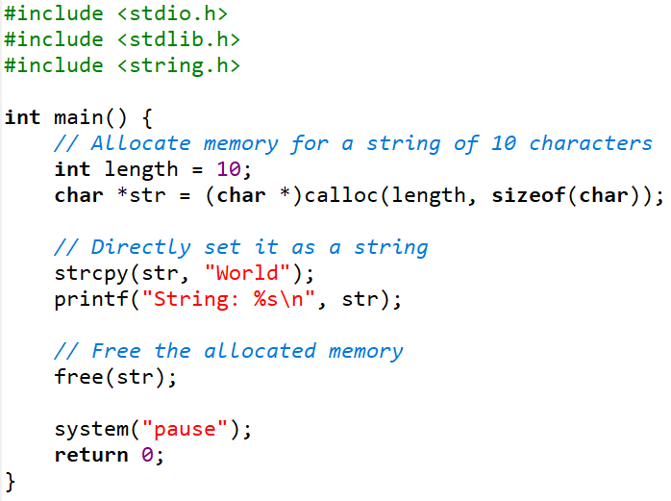
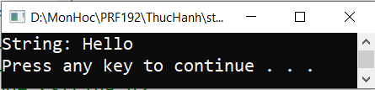
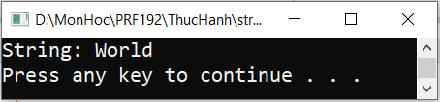
Dynamic Strings: Example

Slide 9
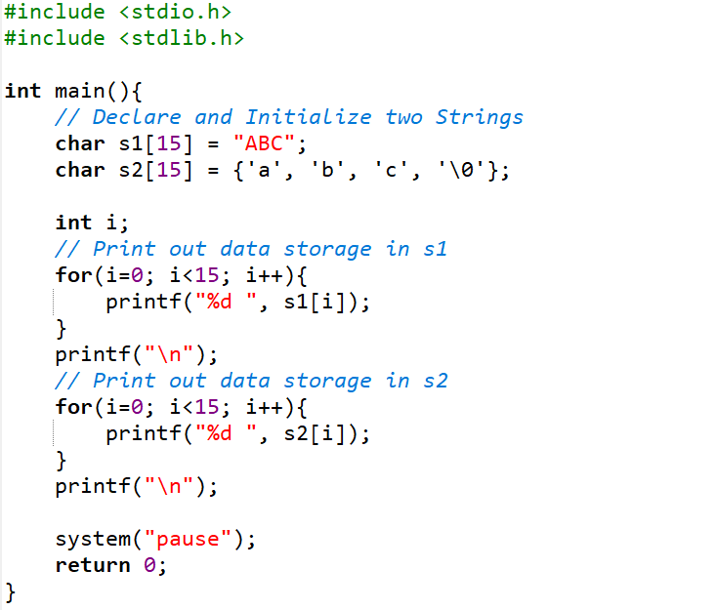
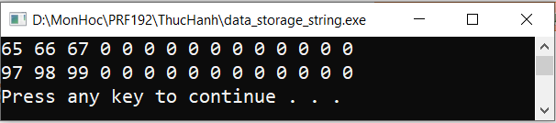
3. Data Stored in a strings
Each character in a string is stored as it’s ASCII code.

Slide 10
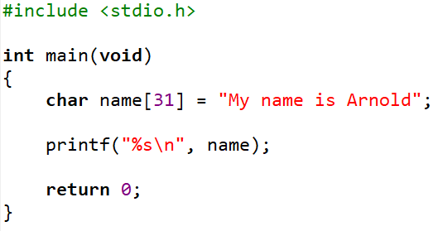

4. Output Strings
Formatted Output:
printf() library functions support the %s conversion specifier for character string output
printf() displays all of the characters from the address provided up to but excluding the null terminator byte. For example:

Slide 11
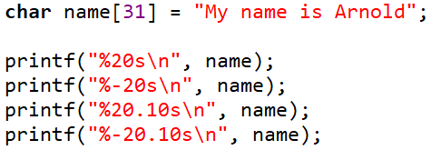
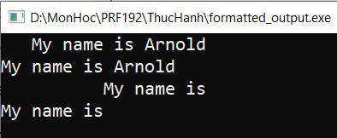
Formatted Output (cont.)
Qualifiers
Qualifiers on the %s specifier add detail control:
%20s displays a string right-justified in a field of 20
%-20s displays a string left-justified in a field of 20
%20.10s displays the first 10 characters of a string right-justified in a field of 20
%-20.10s displays the first 10 characters of a string left-justified in a field of 20
For Example:

Slide 12
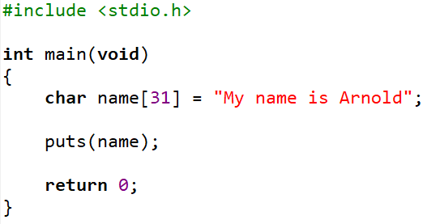
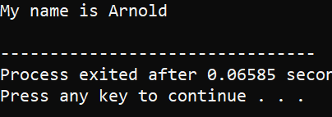
4. Output Strings (cont.)
Unformatted Output:
puts() library function outputs a character string to the standard
Prototype:
Example:
int puts(const char *);

Slide 13
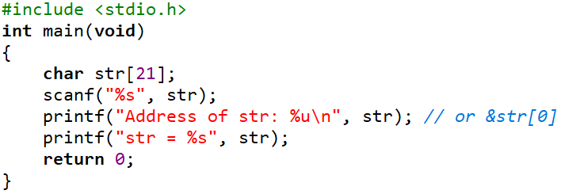

5. Input Strings: Using scanf(…) function
The scanf() library function support conversion specifiers particularly designed for character string input. These specifiers are:
%s - whitespace delimited set.
%[ ] - rule delimited set
The corresponding argument for these specifiers is the address of the string to be populated from the input stream. For example:

Slide 14
scanf(…): %s conversion specifier
%s conversion specifier:
Reads all characters until the first whitespace character
Stores the characters read in the char array identified by the corresponding argument
Stores the null terminator in the char array after accepting the last character
Leaves the delimiting whitespace character and any subsequent characters in the input buffer

Slide 15
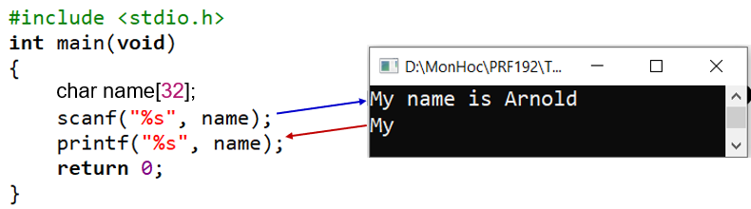
scanf(…): %s conversion specifier (cont.)
Example 1:
The scanf() function will stop accepting input after the character ‘y’ and stores:
The characters ' name is Arnold' remain in the input buffer.

Slide 16
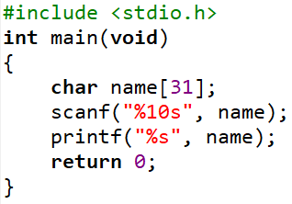
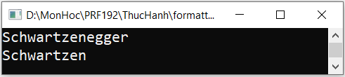
scanf(…): %s conversion specifier (cont.)
Example 2:
The scanf() function will stop accepting input after the character ‘n’ and stores:
The characters ' name is Arnold' remain in the input buffer.

Slide 17
scanf(…): %[^\n] conversion specifier
How to accept blanks in a input string?
%[^\n] conversion specifier:
Reads all characters until the newline ('\n’)
Stores the characters read in memory locations starting with the address passed to scanf
Stores the null byte in the byte following that where scanf stored the last character
Leaves the delimiting character (here, '\n') in the input buffer

Slide 18
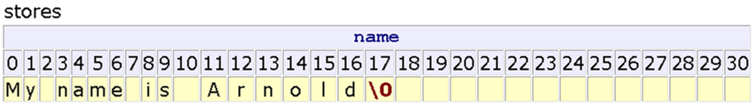
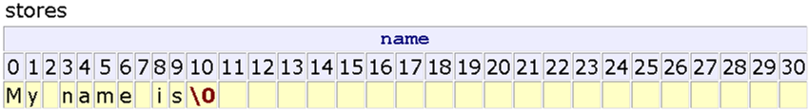
%[^\n] conversion specifier: Example
Example 1:
Example 2:

Slide 19
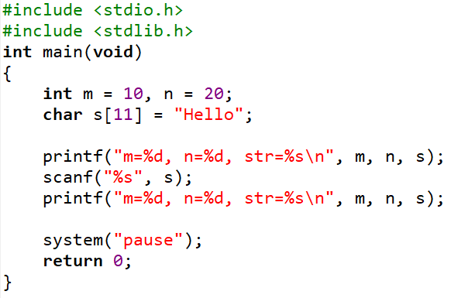
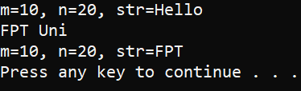
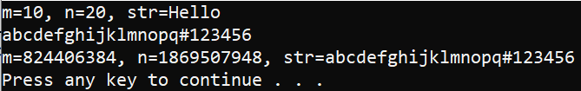
Exercise 1: Input Strings
Compile & Run program
Explain the results of two test cases
Replace and Re-run:
scanf(“%s”, S) scanf(“%10[^\n]”, S)
Why?
Test case 1
Test case 2

Slide 20
scanf(…) - cont.
Some character specifiers used in the function scanf(): Set of character are or not accepted.
Specifier | Description
%[abcd] | Searches the input field for any of the characters a, b, c, and d
%[^abcd] | Searches the input field for any characters except a, b, c, and d
%[0-9] | To catch all decimal digits
%[A-Z] | Catches all uppercase letters
%[0-9A-Za-z] | Catches all decimal digits and all letters
%[A-FT-Z] | Catches all uppercase letters from A to F and from T to Z

Slide 21
5. Input Strings: Using gets(…) function
gets is a standard library function (stdio.h) that:
Accepts an empty string
Uses the '\n' as the delimiter
Throws away the delimiter after accepting the string
Automatically appends the null byte to the end of the set stored.
The prototype for gets is:
Warning: gets is unsafe. Because it does not check the size of the buffer and can lead to buffer overflows.
char* gets(char [ ]);

Slide 22
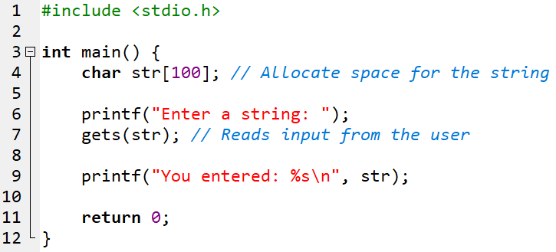
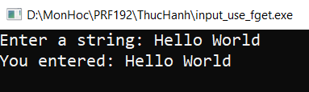
gets(…) function: Example

Slide 23
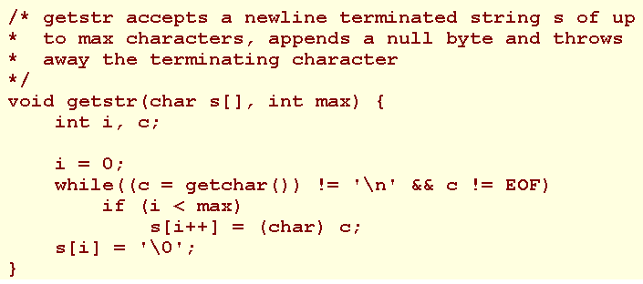
Exercise 2: Input Strings
Using the hints below, write a program that takes in a string of characters and prints it out.
Hint:

Slide 24

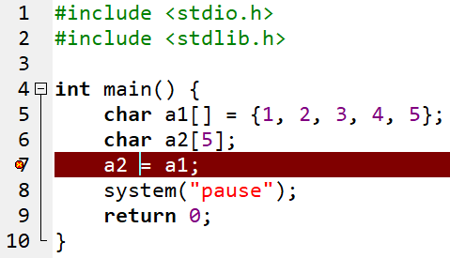
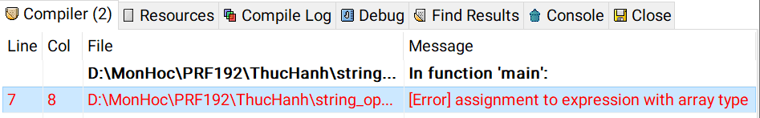
6. May Operators Applied to String?
C operators act on primitive data type only (char, int, float, …)
Can not be applied to static arrays and static strings.
Example:
We need functions for processing arrays and string

Slide 25
String Functions: string.h
Common Funtions | Description
strlen() | Get the length of a string
strcpy() | Copy source string to destination string
strcmp() | Compare two strings
strcat() | Concatenate string src to the end of dest
strupr() | Convert a string to uppercase
strlwr() | Convert a string to lowercase
strstr() | Find the address of a substring
strtok() | Breaks string str into a series of tokens separated by delim

Slide 26
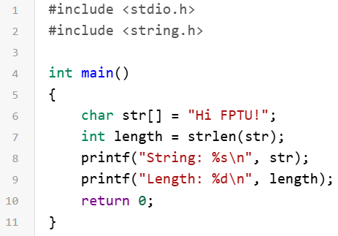

strlen() function
The strlen() function calculates the length of a given string. It doesn’t count the null character ‘\0’.
Syntax:
Example:
int strlen(const char *str);
Output:

Slide 27
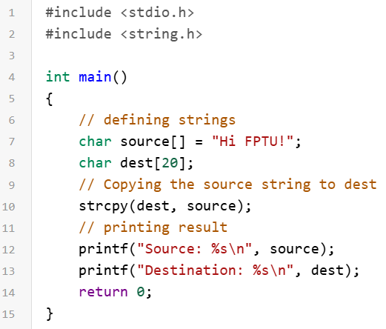

strcpy() function
The strcpy() is a function used to copy one string to another
Syntax:
Example:
char* strcpy(char* dest, const char* src);
Output:

Slide 28
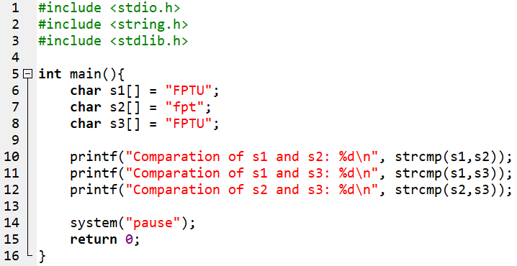
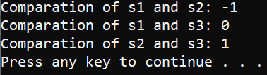
strcmp() function
This function lexicographically compares the first n characters from the two null-terminated strings and returns an integer based on the outcome.
Syntax:
Example:
int strcmp(const char *str1, const char *str2);
Output:

Slide 29
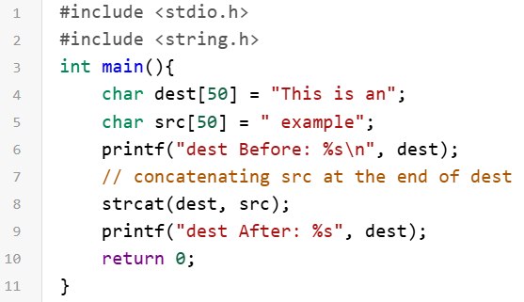

strcat() function
The strcat() function is used for string concatenation. It will append a copy of the source string to the end of the destination string.
Syntax:
Example:
char* strcat(char* dest, const char* src);
Output:

Slide 30
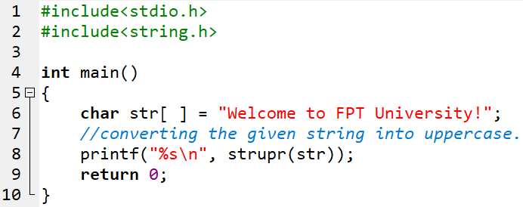

strupr() function
The strupr() function is used to converts a given string to uppercase.
Syntax:
Example:
char *strupr(char *str);
Output:

Slide 31
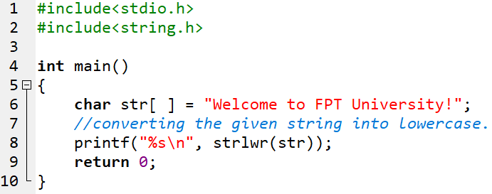

strlwr() function
The strlwr() function is used to converts a given string to lowercase.
Syntax:
Example:
char *strlwr(char *str);
Output:

Slide 32
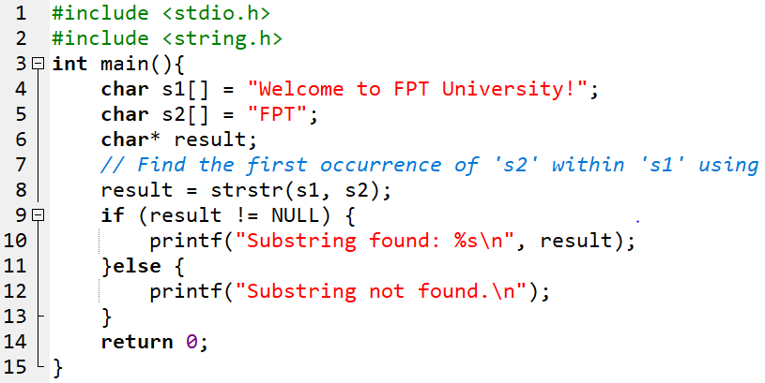

strstr() function
The strstr() function is used to search the first occurrence of a substring in another string.
Syntax:
Example:
char *strstr (const char *s1, const char *s2);
Output:

Slide 33
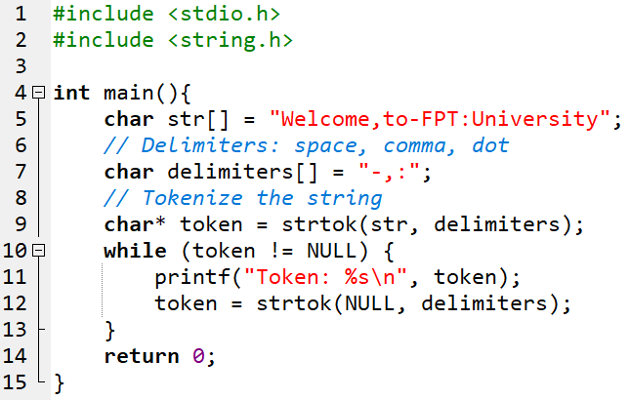
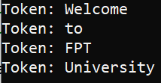
strtok() function
The strtok() function is used to split the string into small tokens based on a set of delimiter characters.
Syntax:
Example:
char * strtok(char* str, const char *delims);
Output:

Slide 34
Exercise 3: Using built-in function (string.h)
Write a program that:
Prompts the user to input two strings.
Compares the two strings and displays whether they are equal or which one is lexicographically greater.
Concatenates the two strings and displays the result.
Calculates and displays the length of the concatenated string.
Searches for a specific character (input by the user) in the concatenated string and displays its position (or indicates if it’s not found).

Slide 35

7. Some User-Defined String Functions
Purpose | Prototype
Trim blanks at the beginning of a string: “ Hello” “Hello” | char* lTrim(char s[])
Trim blanks at the end of a string: “Hello ” “Hello” | char* rTrim(char s[])
Trim extra blanks ins a string: “ I am student ” “I am a student” | char* trim (char s[])
Convert a string to a name: “ hoang thi hoa ” “Hoang Thi Hoa” | char* nameStr( char s[])

Slide 36
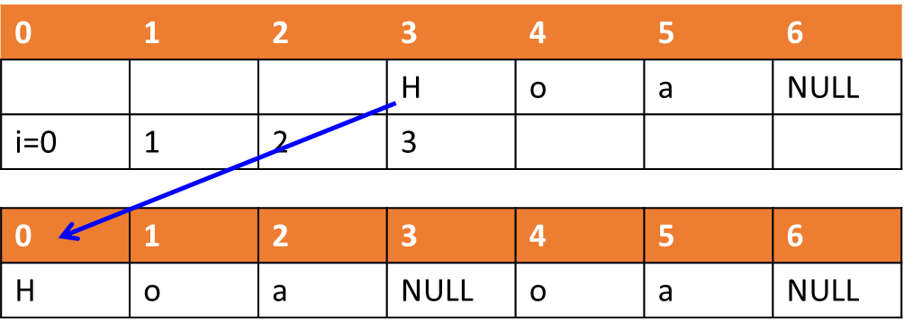
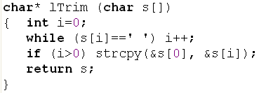
lTrim() user-defined string function

Slide 37
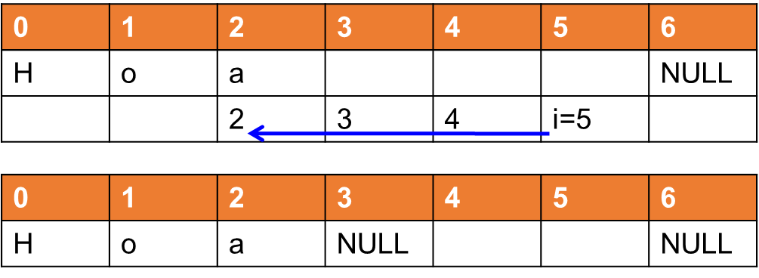
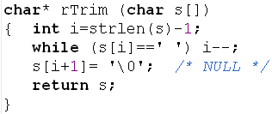
rTrim() user-defined string function

Slide 38
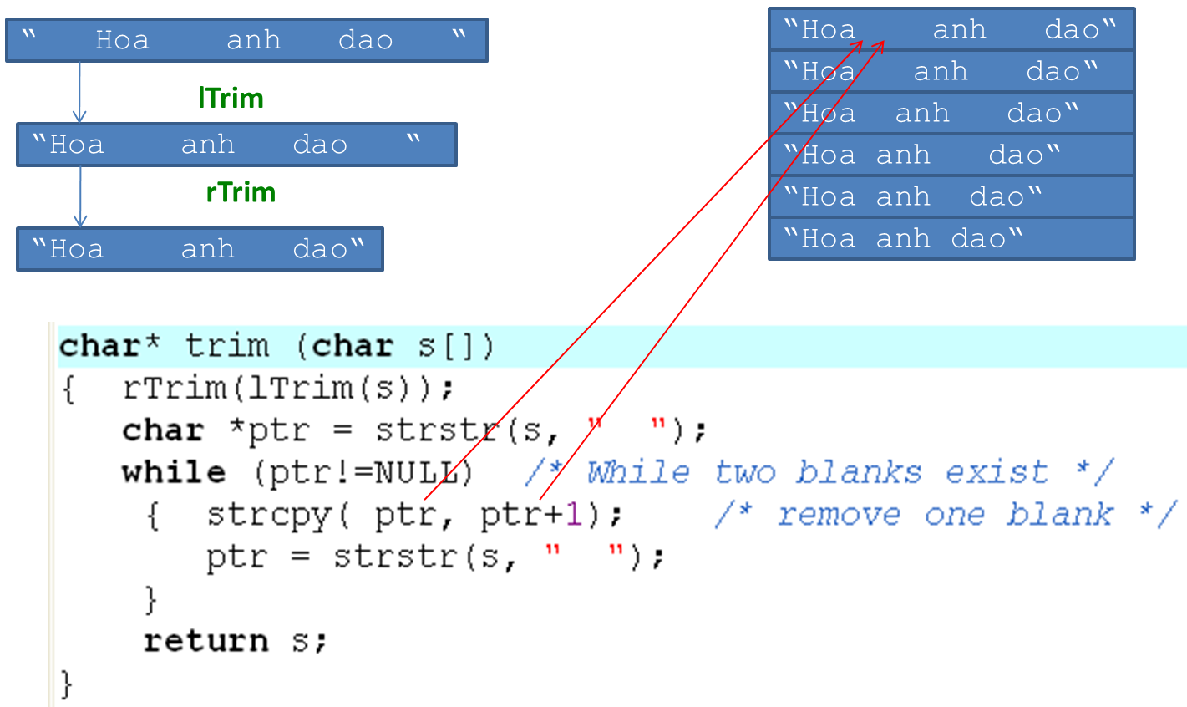
trim() user-defined string function

Slide 39
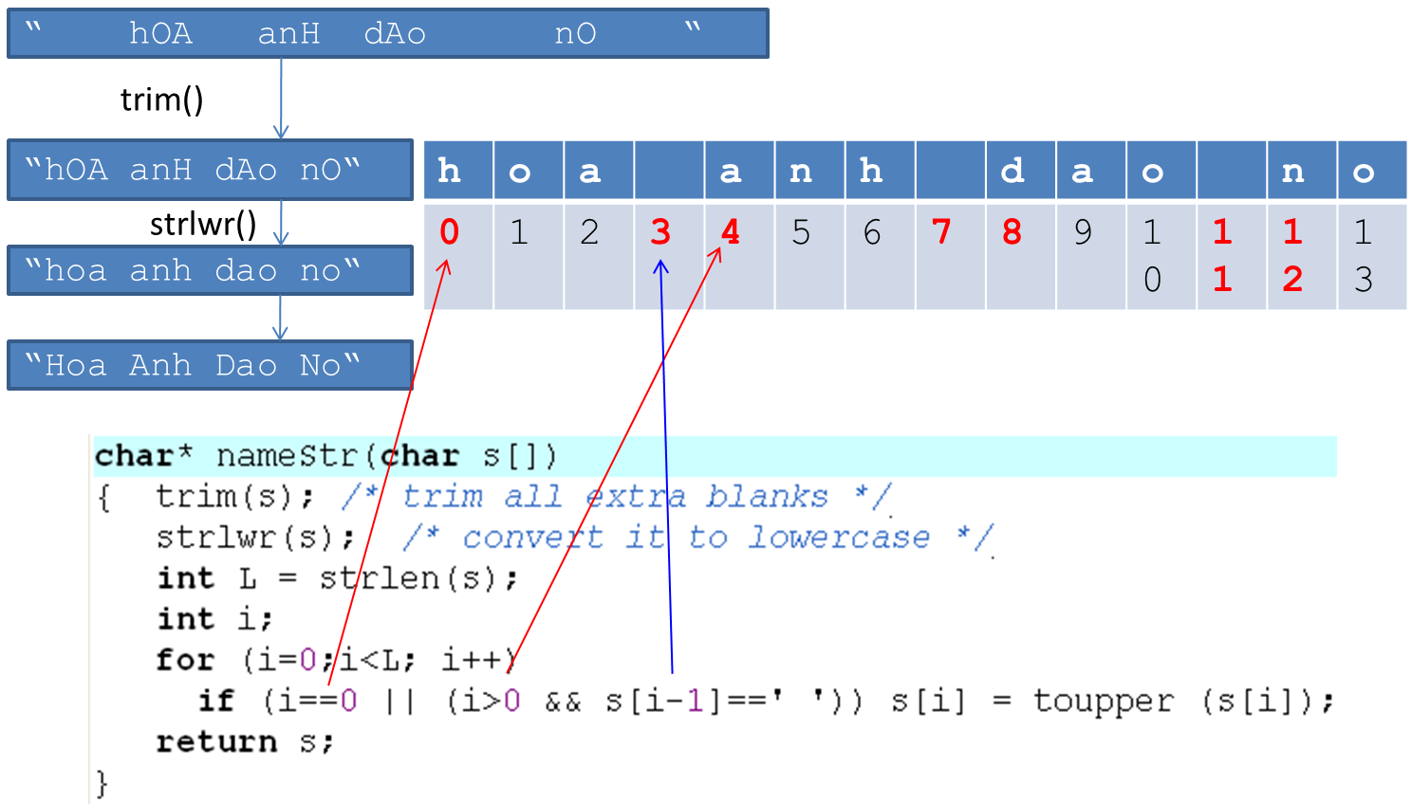
nameStr() user-defined string function

Slide 40
Exercise 4:
Suppose that only the blank character is used to separate words in a sentence. Implement a function for counting number of words in a sentence.
T |  | n | u |  |  | n | a |  | n | u |  |  | n | o | n | g |  |  | t
0 | 1 | 2 | 3 | 4 | 5 | 6 | 7 | 8 | 9 | 10 | 11 | 12 | 13 | 14 | 15 | 16 | 17 | 18 | 19
i
count
0
1
2
3
4
5
6
Counting words in a string
Do Yourself
Criteria for increasing count:
- s[i] is not a blank and (i==0 or s[i-1] is a blank)

Slide 41
Exercise 5:
Counting integers in a string
1 | 2 | n | u | a | 7 | n | a | 9 | d | f | 1 | 2 | 3 | 4 | 5 | 9 | P | 7
0 | 1 | 2 | 3 | 4 | 5 | 6 | 7 | 8 | 9 | 10 | 11 | 12 | 13 | 14 | 15 | 16 | 17 | 18 | 19
i
count
0
1
2
3
4
5
Criteria for increasing count:
- s[i] is a digit and (i==0 or s[i-1] is not a digit)
Do Yourself

Slide 42
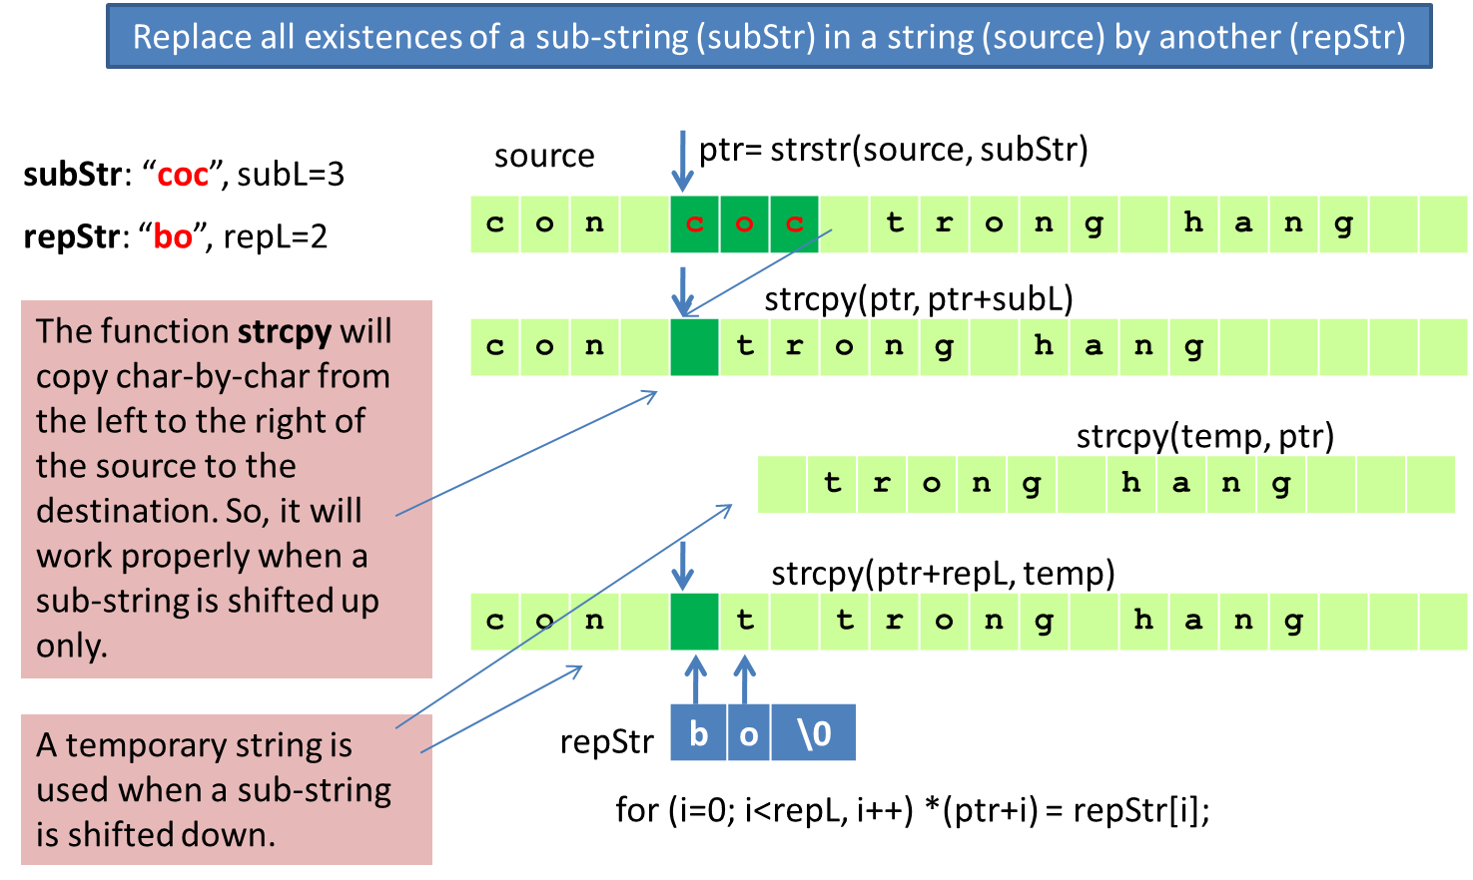
Exercise 6:
Do Yourself

Slide 43
8. Array of Strings
A string array declaration takes the form
For example, to declare an array of 5 names, where each name holds up to 30 characters, we write:
char names[5][31];
or:
char names[5][31] = { "Harry", "Jean", "Jessica", "Irene", "Jim" };
char identifier [numberOfString][number_byte_per_string];

Slide 44
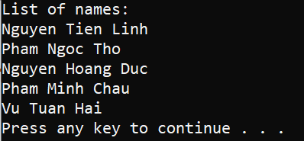
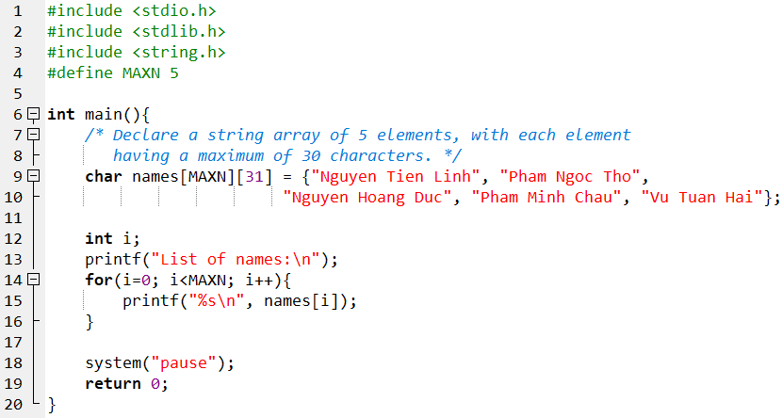
Array of Strings (cont.)
Example:
Output:
Initialization

Slide 45
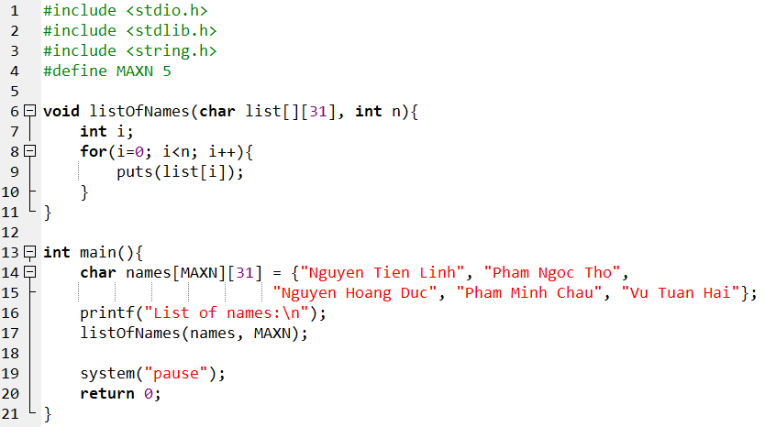
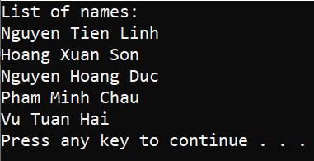
Array of Strings: Parameter in a function
Example:
Parameter is a Array of String
Output:

Slide 46


Exercise 7:
Write a C program that will accept 10 names, print out the list, sort the list using ascending order, print out the result.
Students complete this exercise based
on the code design prototype below.
Hint:

Slide 47



Exercise 7: Sample output

Slide 48
Summary
String in C is terminated by the NULL character (‘\0’)
A string is similar to an array of characters.
All input functions for string will automatically add the NULL character after the content of the string.
Using the functions on arrays, strings are implemented to operate on arrays and strings.
If dynamic arrays or strings (using pointers), the assignment can be used on these pointers.

Slide 49
Summary
String Input
scanf; gets
Do yourself using getchar()
String Functions and Arrays of Strings
Functions: strlen(), strcpy(), strcmp(), strcat(), strupr(), strlwr(), strstr(), strtok()
Arrays of Strings
Input and Output
Passing to Functions
Sorting an Array of Names

